Slide 1
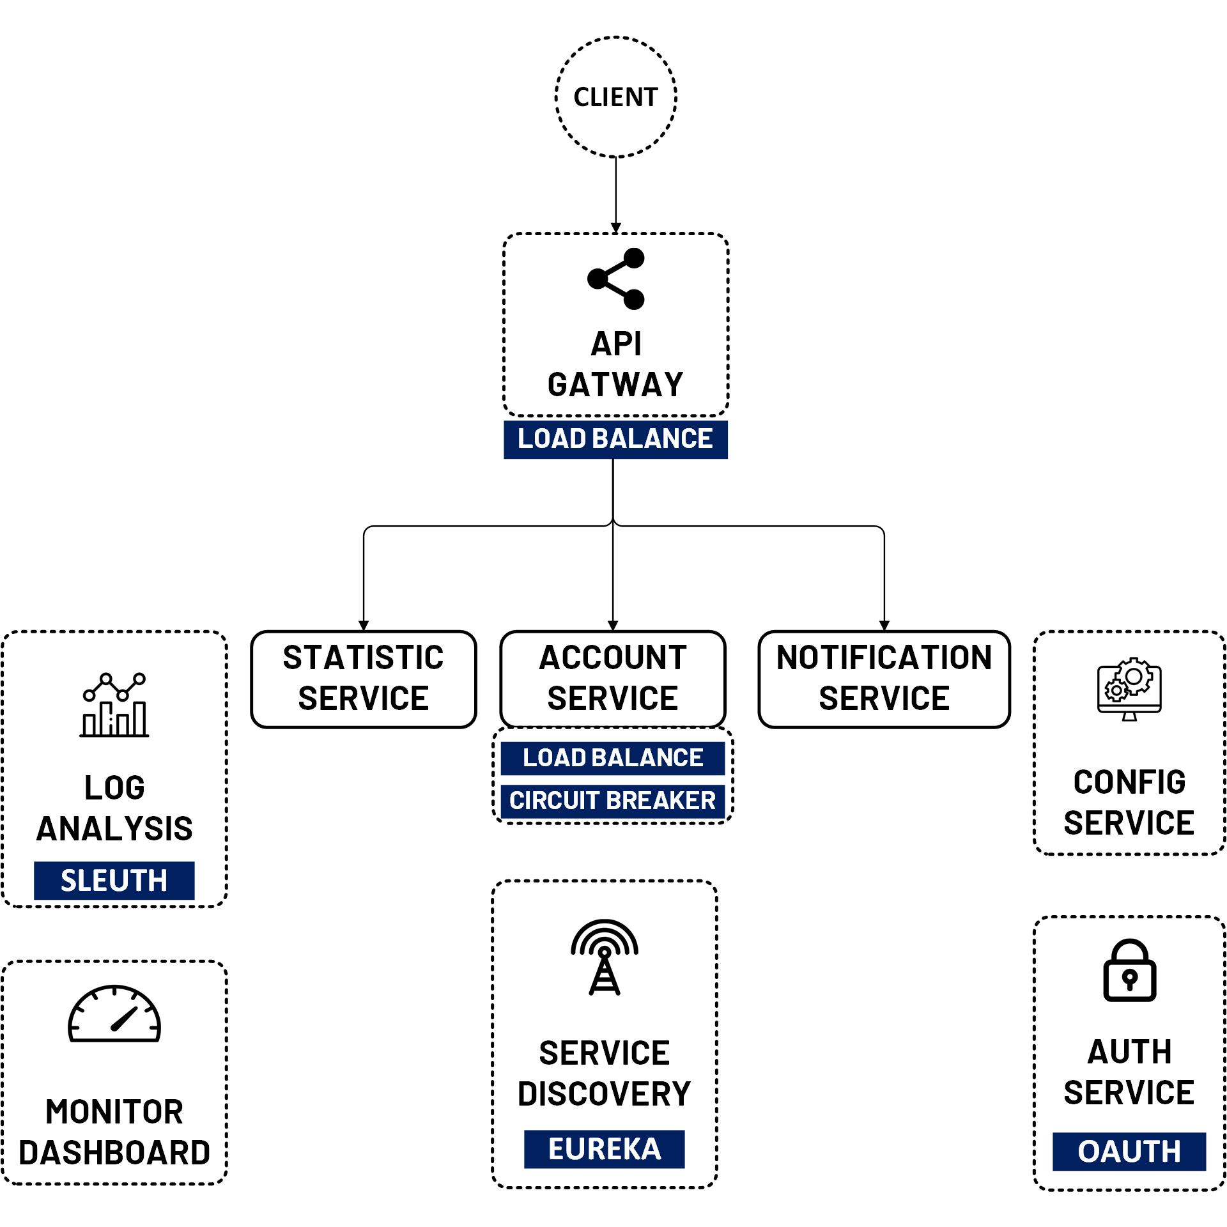

Spring Cloud Discovery
www.jmaster.io/course/microservices-with-spring-cloud

Slide 2
Discovery Server is Service Registry
Like a phone book of microservice.
Manage status, metadata of services such as: IP address, hostname, port, etc.
Register and Find services in Service Registry
Standalone server

Slide 3
Discovery Client
Register service and send a heartbeat signal to the service registry
Find and communicate with each other service without hard-coding hostname and port
Makes all further requests to any other services through a load-balancing algorithm.

Slide 4
